Slide 1
Experiment result tracing
In working

Slide 2
Analysis
case | _1(0225)
gender | m
glass | y
vb | vc | 2 | 4 | 6 | 8 |  | va | vd | 1 | 3 | 5 | 7
1 | 2 | 3 | 4 | 5 | 6 |  | 7 | 8 | 9 | 10 | 11 | 12
9:53:28 | 9:55:28 | 9:57:07 | 9:59:46 | 10:02:02 | 10:04:04 |  | 10:04:20 | 10:05:35 | 10:07:08 | 10:09:10 | 10:11:08 | 10:13:11
9:54:22 | 9:56:25 |  |  |  |  |  | 10:05:25 | 10:06:42
165 | 164 | 10(14) |  |  |  |  | 133 | 132 | 6(8)
case | _2(0225)
gender | m
glass | y
1 | 2 | 3 | 4 | 5 | 6 |  | 7 | 8 | 9 | 10 | 11 | 12
11:09:35 | 11:10:54 | 11:12:38 | 11:14:29 | 11:16:40 | 11:18:49 |  | 11:21:19 | 11:22:34 | 11:23:52 | 11:25:44 | 11:27:30 | 11:29:30
11:10:35 | 11:11:57 |  |  |  |  |  | 11:22:22 | 11:23:39
147 | 140 | 13(14) |  |  |  |  | 135 | 133 | 6(8)
case | _3(0225)
gender | f
glass | n
1 | 2 | 3 | 4 | 5 | 6 |  | 7 | 8 | 9 | 10 | 11 | 12
11:43:47 | 11:45:13 | 11:47:16 | 11:49:19 | 11:49:30 | 11:51:32 |  | 11:51:46 | 11:54:02 | 11:55:29 | 11:57:37 | 0:06:41 | 0:08:43
11:44:55 | 11:46:07 |  |  |  |  |  | 11:52:51 | 11:55:01
132 | 162 | 11(14) |  |  |  |  | 137 | 147 | 4(8)
case | _4(0226)
gender | m
glass | y
1 | 2 | 3 | 4 | 5 | 6 |  | 7 | 8 | 9 | 10 | 11 | 12
11:43:28 | 11:45:02 | 11:47:15 | 11:49:20 | 11:50:12 | 11:53:41 |  | 11:56:05 | 11:57:26 | 11:59:24 | 12:01:02 | 12:02:34 | 12:04:26
11:44:20 | 11:45:58 |  |  |  |  |  | 11:56:59 | 11:58:30
171 | 158 | 12(14) |  |  |  |  | 166 | 140 | 6(8)

Slide 3
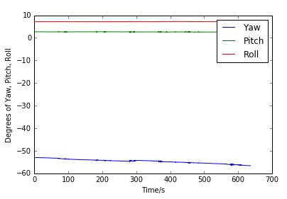
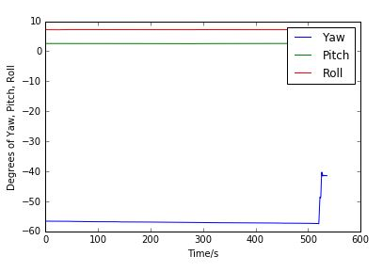
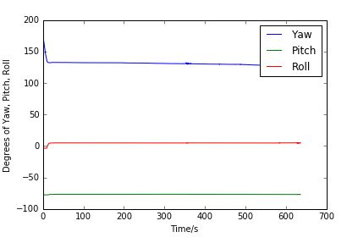
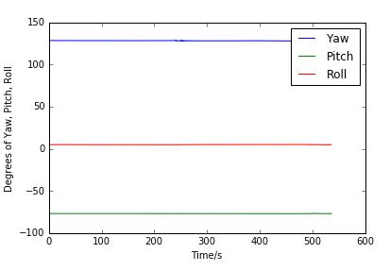
Case1
Paper
Ipad
Gender/m
Glass/y
Text Accuracy: 164.5 words/min
Image Distinguish: 71.4%
Text Accuracy: 132.5 words/min
Image Distinguish: 75%
rotation
Tilt（46639 points）

Slide 4
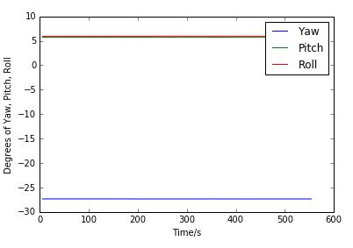
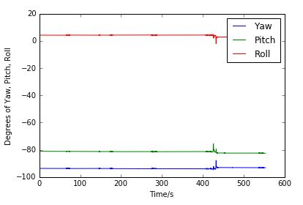
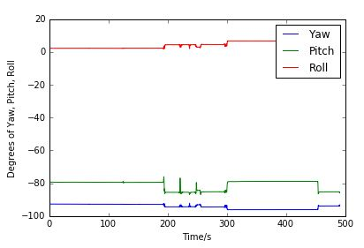
Case2
Paper
Ipad
Gender/m
Glass/y
Text Accuracy: 143.5 words/min
Image Distinguish: 93%
Text Accuracy: 134 words/min
Image Distinguish: 75%
rotation
rotation
tilt

Slide 5
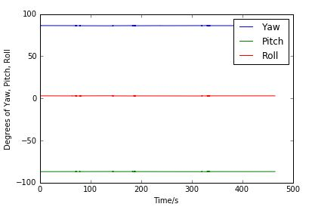
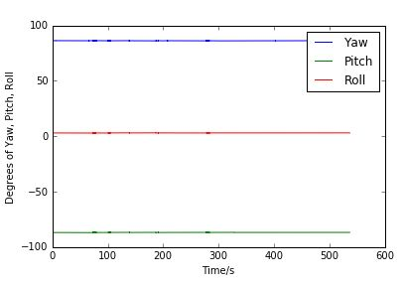
Case3
Paper
Ipad
Gender/f
Glass/n
Text Accuracy: 145 words/min
Image Distinguish: 78%
Text Accuracy: 142 words/min
Image Distinguish: 50%
rotation
tilt

Slide 6
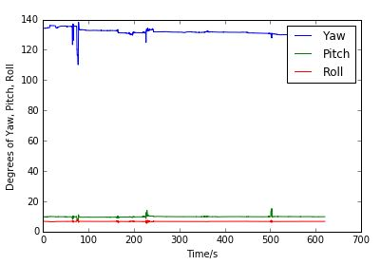
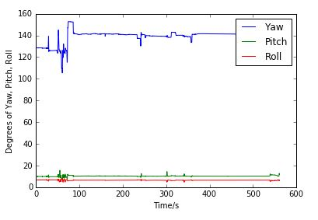
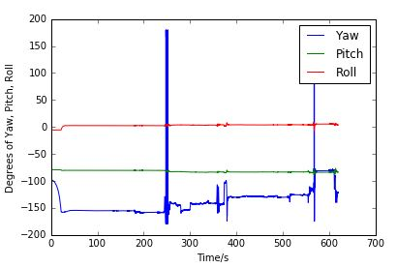
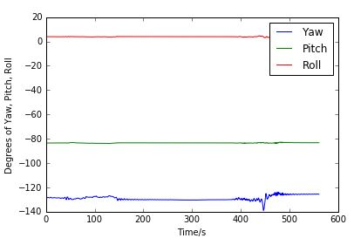
Case4
Paper
Ipad
Gender/m
Glass/y
Text Accuracy: 164.5 words/min
Image Distinguish: 85%
Text Accuracy: 153 words/min
Image Distinguish: 75%
rotation
tilt

Slide 7
Case Comparison
Text Accuracy&Image Distinguish between cases.

Slide 8
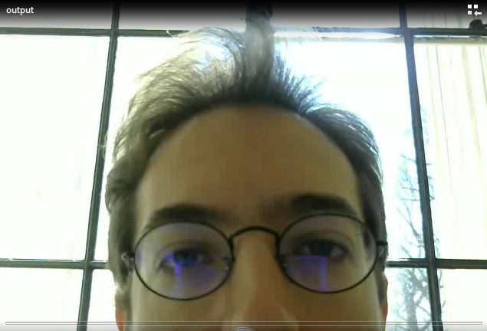
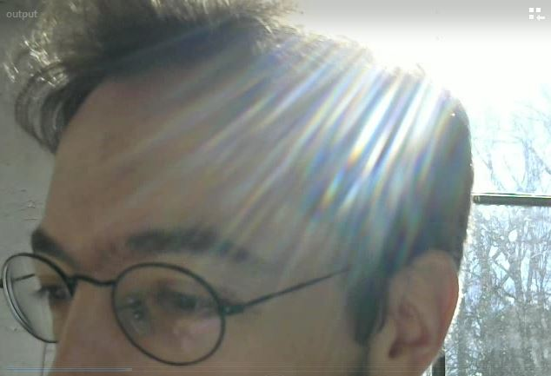
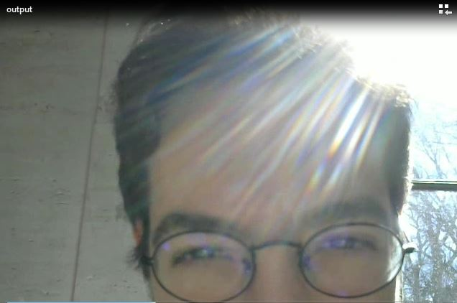

Facial detection failure

Slide 9
Feedback
Text test is a little bit boring.
Image test is interesting.
When glare is severe, feels frustrated/painful.
Problem: Rotation&tilting tracking crushed in Spyder console. Solution: Use sublime.
Facial detection lost data.

Slide 10
Case5
Gender/m
Glass/y
Paper
Text Accuracy: 151.5 words/min
Image Distinguish: 100%
Ipad
Text Accuracy: 143 words/min
Image Distinguish: 100%

Slide 11
Case5
Gender/m
Glass/y
Paper
Text Accuracy: 151.5 words/min
Image Distinguish: 100%
Ipad
Text Accuracy: 143 words/min
Image Distinguish: 100%

Slide 12
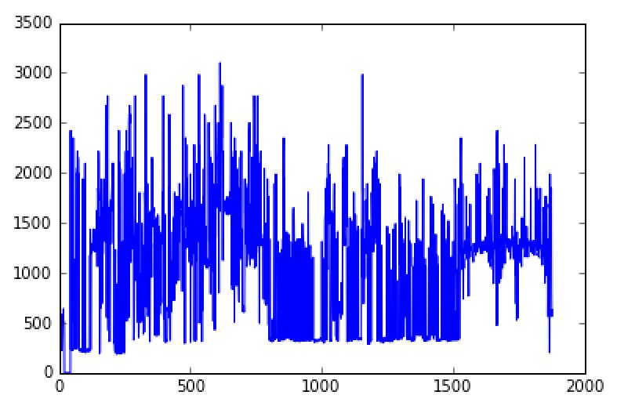
Case5
Gender/m
Glass/y
2017-04-28 11:56:17 259,46 61.1940298507
2017-04-28 11:56:18 268,76 488.095238095
2017-04-28 11:56:18 269,77 512.5
2017-04-28 11:56:18 271,77 512.5
2017-04-28 11:56:18 165,268 500.0
2017-04-28 11:56:18 204,393 301.470588235
2017-04-28 11:56:18 290,180 488.095238095
2017-04-28 11:56:18 202,386 250.0
2017-04-28 11:56:19 270,78 525.641025641
2017-04-28 11:56:19 272,77 525.641025641
2017-04-28 11:56:19 331,348 225.274725275
2017-04-28 11:56:20 30,118 427.083333333
2017-04-28 11:56:20 311,194 539.473684211
2017-04-28 11:56:20 318,199 585.714285714
2017-04-28 11:56:22 271,76 512.5
2017-04-28 11:56:23 311,201 640.625
2017-04-28 11:56:23 310,199 512.5
2017-04-28 11:56:23 311,198 512.5
2017-04-28 11:56:23 311,198 512.5
2017-04-28 12:13:51 125,5 0.0
2017-04-28 12:13:51 148,134 0.0
2017-04-28 12:13:51 130,6 0.0

Slide 13
Reorganize the data structure flow
Input accuracy
text1
text2
Average score
Basic information
Paper test test time for each
image3
image4
Average score
image5
image6
Visualization Model
text1
text2
Average score
Control data collected from GUI
Ipad test time for each
image3
image4
Average score
image5
image6
Facial data
Motion data
Solar data
Total time
Average by minute
Average by minute

Slide 14
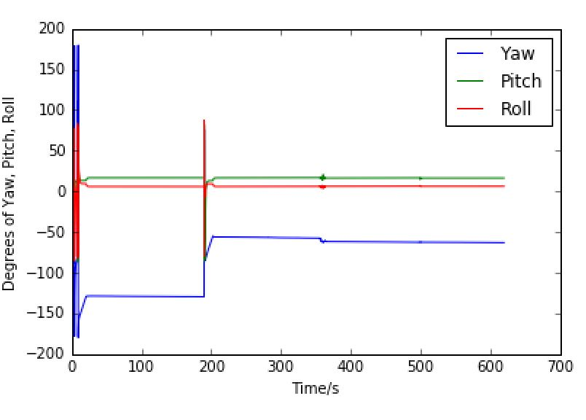
Case6
Gender/F
Glass/N
Paper
Text Accuracy: 144.5 words/min
Image Distinguish: 57%
Ipad
Text Accuracy: 159 words/min
Image Distinguish: 50%

Slide 15
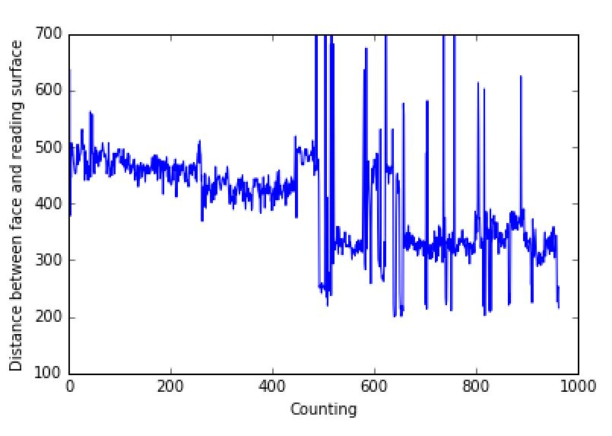
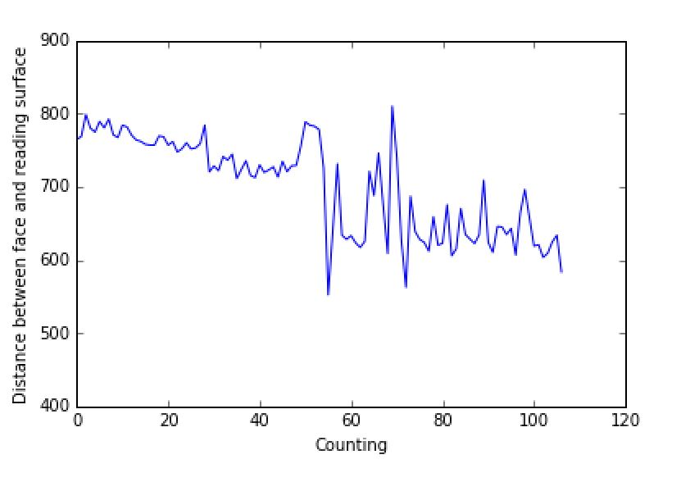
Facial analysis improvement
Gender/F
Glass/N
Distance analysis: Remove number > 3rd quantile

Slide 16
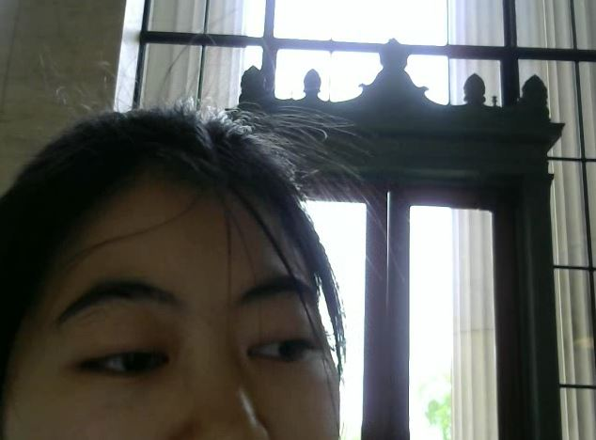

Facial analysis improvement
Gender/F
Glass/N
450
Camera: 640*480
How to normalize position?
Reverse relationship
0
600

Slide 17
Trends update
Text test and preference

Slide 18
Trends update
Image test

Slide 19
Trends update
Face position: case 8 analysis

Slide 20
Trends update
Face position: case 9 analysis

Slide 21
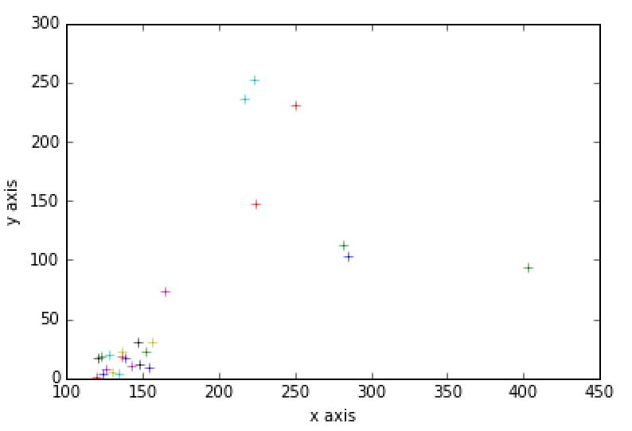
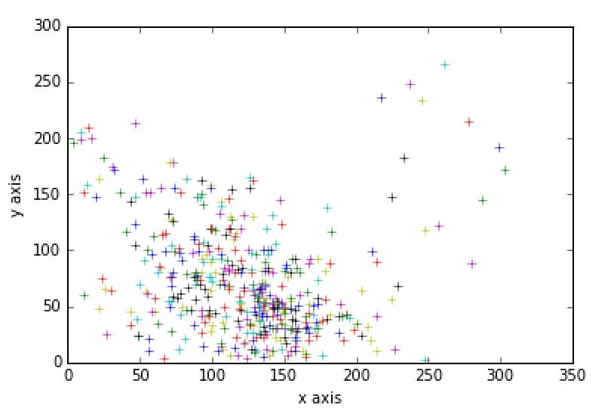
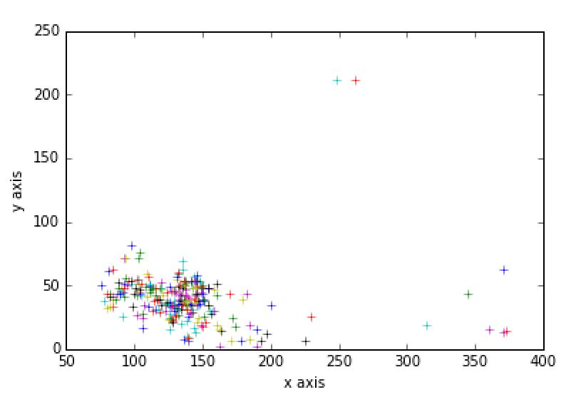
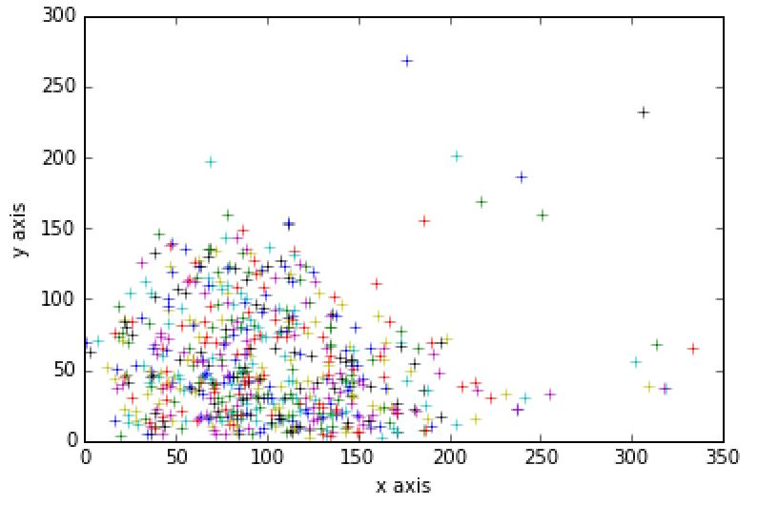
Trends update
Image test
Ipad text
Ipad image
Paper text
Paper image

